Slide 1
Project Iteration - 1
CSE 6324
Christoph Csallner
University of Texas at Arlington (UTA)
Project Title: Conkas 2.0 - Static Analysis Tool
Team - 6
Apoorva Siri Mattewada - 1002026609
Harshith Kannalli Sachidananda Murthy -1001949874
Manisha Sohanlal Jain - 1001869817
Vinayak Neemkar - 1002022438
Vignaan Erram - 1002032121

Slide 2
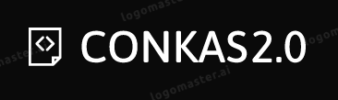
Outline
Project Plan
Risk and Mitigation Plan
Comparison with Competitors
Specification and Design
Workflow
Code and Tests
Target Users/Customers of the Tool
Feedback
Project Github Link
Acknowledgements
References
Notes:
Goal: 34 pts
Significantly exceeds expectations
Excellent coverage of presentation topic; contents are highly innovative and original; contents are analyzed in depth; presentation does not contradict itself or common knowledge.

Slide 3
Project Plan
Iteration | Goals | Achieved Goals
1 | To run the conkas tool successfully and test it with some sol files. And understand what the tool is doing. And fix any dependency issues if there are any. | Successfully installed the tool and fixed the versions of the libraries, solved some compatibility and dependency issues; run the sample .sol files successfully. Working on bad randomness vulnerability.
2 | Come up with suitable code for the “bad randomness” vulnerability and integrate it in our tool.
3 | Work on the “short address attack” vulnerability. Finally, test all the modules and run it on the tool successfully.

Slide 4
Risks and Mitigation Plan
Risks | Explanation | Resolution | Severity
Process Knowledge Risk | Difficulty in understanding the tool and working around it’s complexities. | All team members are trying their best to learn about the tool and share their knowledge in the meetings. | High
Integration Risk | Encountering issues while integrating bad randomness vulnerability in the current version of code. | Generating a proper understanding of code and figuring out where the bad randomness module needs to be placed, via custom modules. Parallel check on dependencies is done. | Medium
Missing Risk | Conkas project does not seem very active (few commits/issues to git), may be hard to reach the community. | We are trying to find more information about the tool by contacting people how worked on smart contracts, github stargazers, etc. | Low
Notes:
Pragma solidity changes result in changes for existing tool.
Dependency Issues which was not

Slide 5
Risks and Mitigation Plan
Risks | Explanation | Resolution | Severity
Logical Risk | Instances where code for bad randomness cannot detect said vulnerabilities. It may generate false positives and false negatives. | This risk can be handled by testing and debugging code for issues. | High
Increased Complexity | Adding a new vulnerability detection rule can increase complexity of the analysis tool, potentially making it difficult to maintain and update overtime. | Creating a separate files for bad randomness vulnerability to allow easier management and create efficient and readable code. | Medium
Reduced Performance | Adding new rules to the smart contracts can increase the performance time. | Using algorithms and data structures that are specifically designed for detecting bad randomness in smart contracts, via., efficient time and space complexity. | Medium

Slide 6
Comparison with Competitors
Tool Name | Execution Time | Accepted Input
Slither | Good Execution Time | Only .sol file
Conkas | Good Execution Time | bytecode/.sol file
Mythril | Bad Execution time | bytecode/.sol file

Slide 7
Specification and Design
Solidity Code and Bytecode input support.
Command Line Interface Support.
Support for custom vulnerability scanning (specify the type of vulnerability to search).
Support for custom modules.
Support for EVM instructions.
Unit test support.
System Requirements:
Python3
Modules: cobr2, py-solc-x, pycryptodome, pyevmasm, solidity_parser, z3-solver, solc-select.
Notes:
Comprehensive and detailed list of all inputs and outputs; all key data structures are documented and appropriate for app features; each implemented feature has a use-case or mock screen shot transition graph, covering all exceptional cases; use-cases or screen shot transition graphs do not conflict with each other.

Slide 8
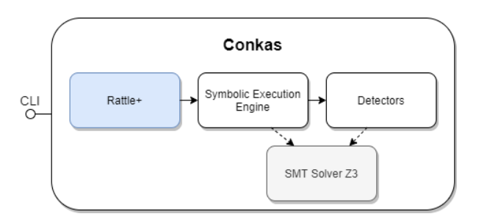
Workflow - The Conkas tool
[1]

Slide 9
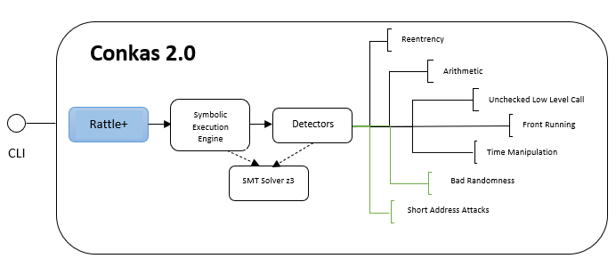
Workflow - Conkas 2.0 Project
Notes:
Addressing a remark: Little detail on how/why this will work–conkas tool workflow- how/where your work fits in – high level idea of what your code will be doing - addressed here.

Slide 10
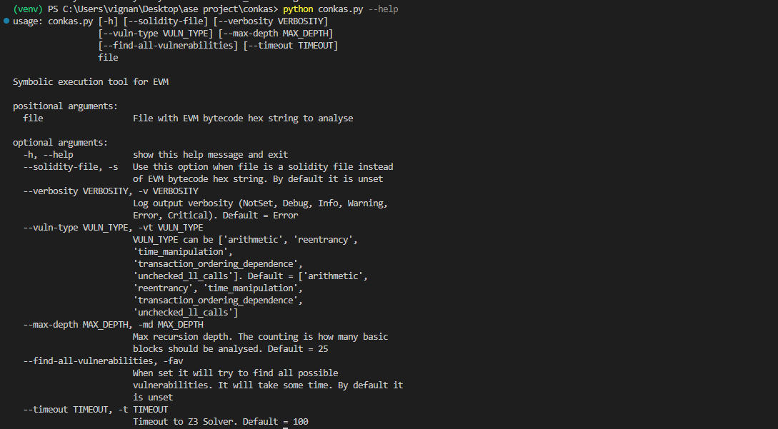
Code and Tests (Input)
$ python conkas.py -vt reentrancy -s file_name.sol - Command line input given for solidity file
$ python3 conkas.py file_name.bin - Command line input given for bytecode file.

Slide 11
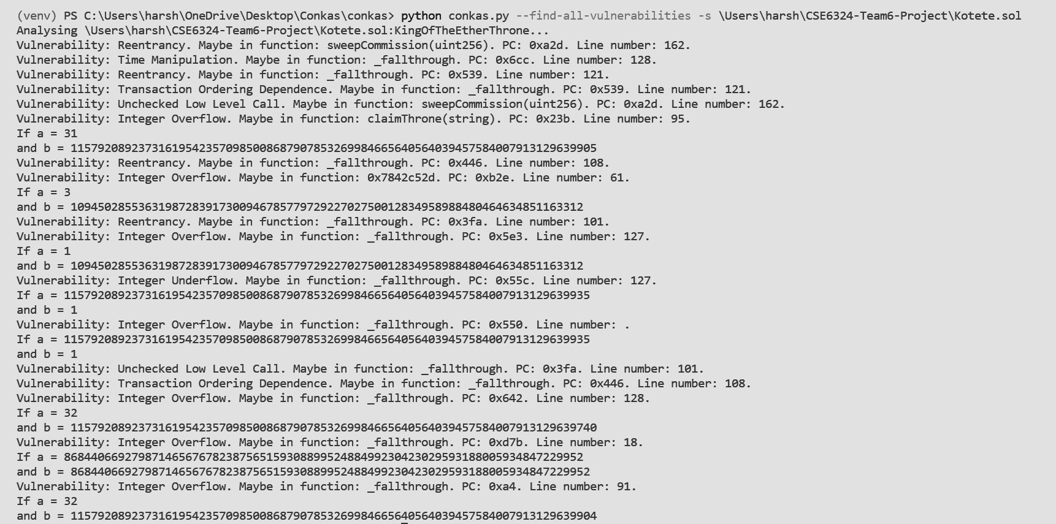
Code and Tests (Output)

Slide 12
Target Users/Customers of the Tool
All smart contract developers who wish to work on lottery and raffle smart contracts for gambling.
People who use payment processing smart contracts want to check for short address vulnerability.
All professors and students who desire to do study on this type of tool are welcome to utilize it.
People that want to modify it and add new features can adopt it.

Slide 13
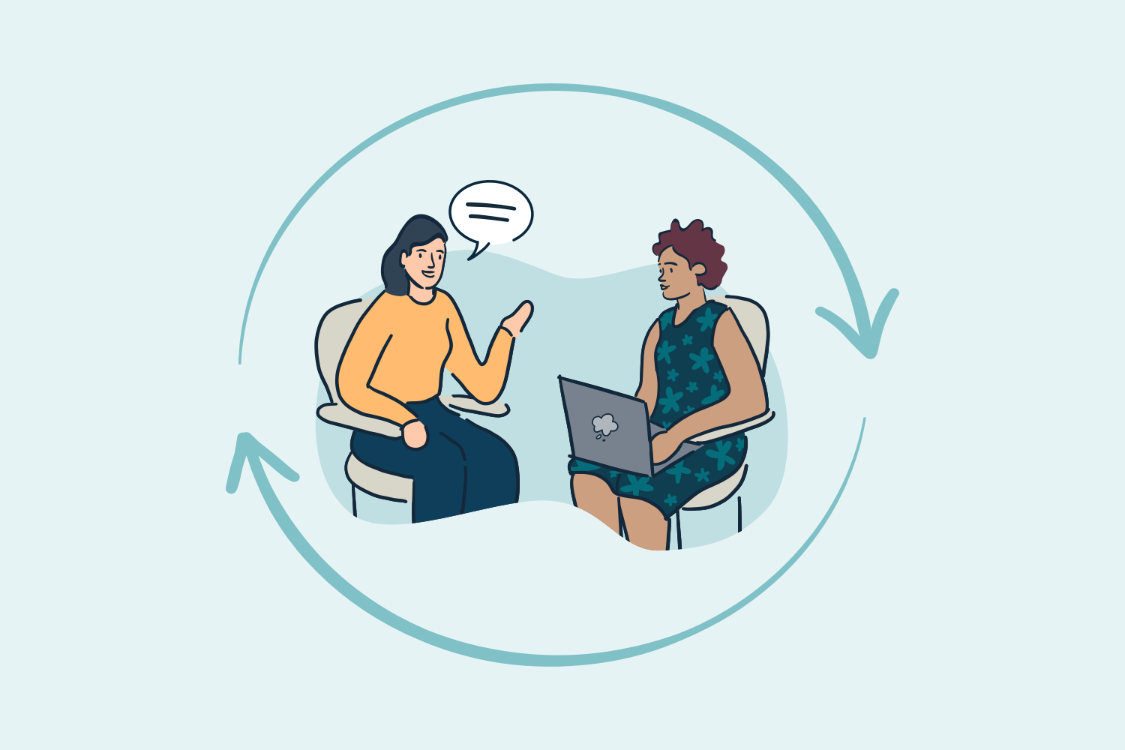
Feedback
Alexander Norta & Toomas Lepikult - “Conkas’s primary known limitation is its inability to detect smart contract dependency files”. [2]
Shovon Pereira - “Good tool to work on. If I were to share my bytecode files instead of .sol files for security reasons, this tool would do the job for me”.
[3]
Notes:
Do you have a concrete customer/user you can get feedback from?
It is a fairly new tool released in 2021 - someone’s masters thesis, so it is not widely used. (Generate personal and peer feedback?)

Slide 14
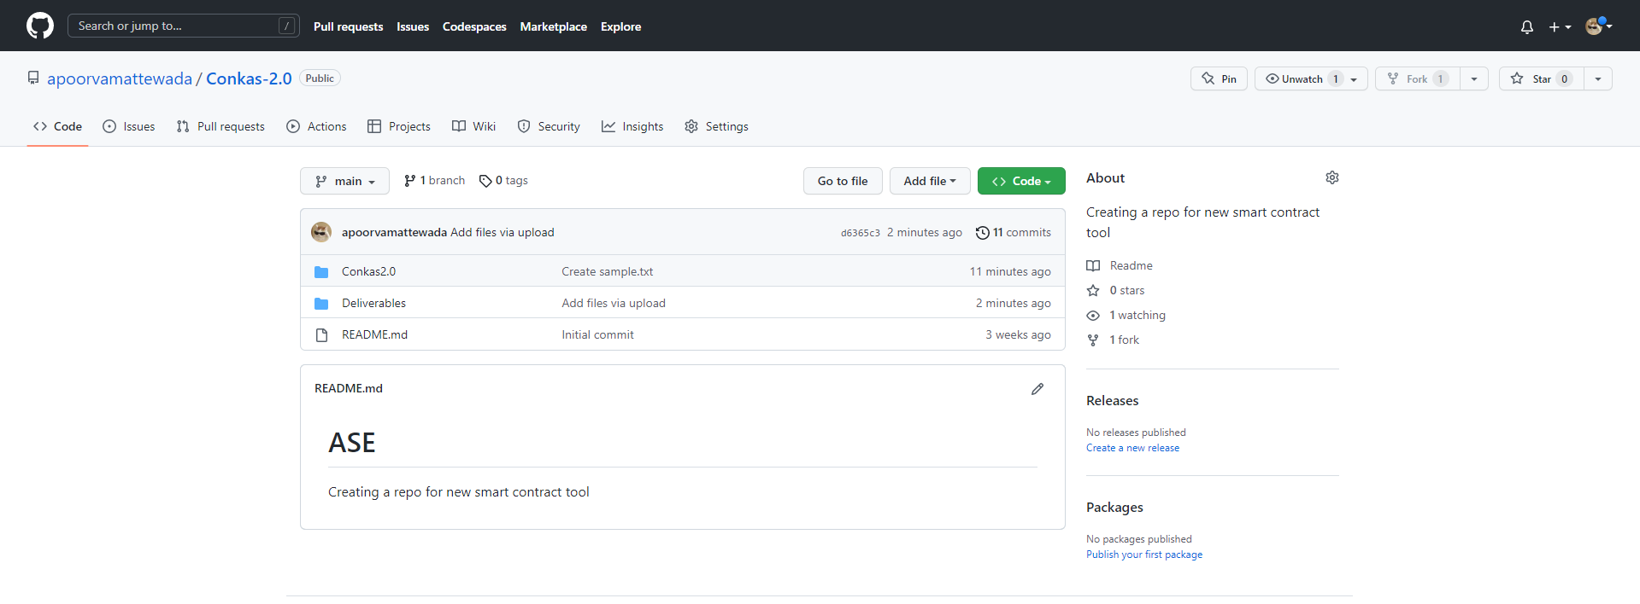
Project Github Link
https://github.com/apoorvamattewada/Conkas-2.0
[4]

Slide 15

Acknowledgements
Dr. Christoph Csallner
Shovon Pereira
Mohammad Rafiq Arefin
[5]

Slide 16
References
[1]https://www.semanticscholar.org/paper/Conkas%3A-A-Modular-and-Static-Analysis-Tool-for-Veloso/425e474177885f9ac9e57d44e8e2386d13f9c87d
[2]https://digikogu.taltech.ee/et/Download/1c564244-622c-4b84-9af1-743b67f5400e/Nutilepingutehaavatavustetuvastamisetriistade.pdf
[3]https://www.thinkcompany.com/blog/customer-feedback-loops-6-things-to-consider-when-setting-one-up/
[4]https://github.com/apoorvamattewada/Conkas-2.0
[5]https://stock.adobe.com/search?k=acknowledgment
Notes:
Anyone- add images to the ppt, link it here.

Slide 17
THANK YOU

